Slide 1
Consumer Choice in Healthcare
These views do not necessarily reflect those of the DOJ

Slide 2
Healthcare Spending is High
20% of US GDP spent on healthcare.
It is believed that a significant percent of that spending is wasteful. Bottom estimate 2%.
Consumers do not shop around for alternative options perhaps because insurance covers most of the cost.

Slide 3
Consumerism in Healthcare
Proposals include health plans with greater cost sharing, e.g. high deductible plans. For example, most ACA replacement bills include language for a high deductible plan option.
If consumers footed a larger portion of the bill, would they shop around?
  Greater cost sharing increases the benefit of search.
  Other factors still important, doctor-patient relationships, perceived quality, convenience, and price opaqueness.

Slide 4
Literature
Most focused on external margin, not choice conditional on treatment decision.
Kolstad et. al. 2017 (QJE)
  Consumers reduce quantities across the spectrum of health care services, including potentially valuable care (e.g.services) and potentially wasteful care (e.g. imaging services).”

Slide 5
Knee MRIs
Standard procedure. Almost all Radiologists/facilities can perform this procedure.
Often used diagnostically, non-emergent issues.
Easy to shop around. Can be done by any radiologist with an MRI machine.
Significant price dispersion.
  Total costs between $100s-$1000s.
  Patients costs between $0 and full cost.
Already some experiments to push consumers to lower price options. E.g. gift cards, calls, website apps.

Slide 6
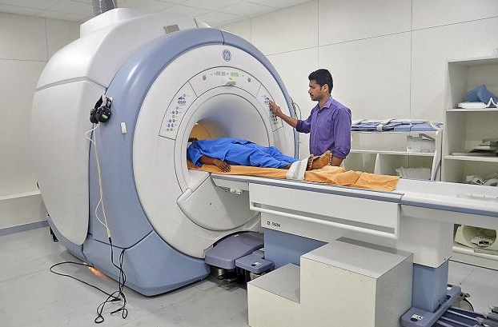
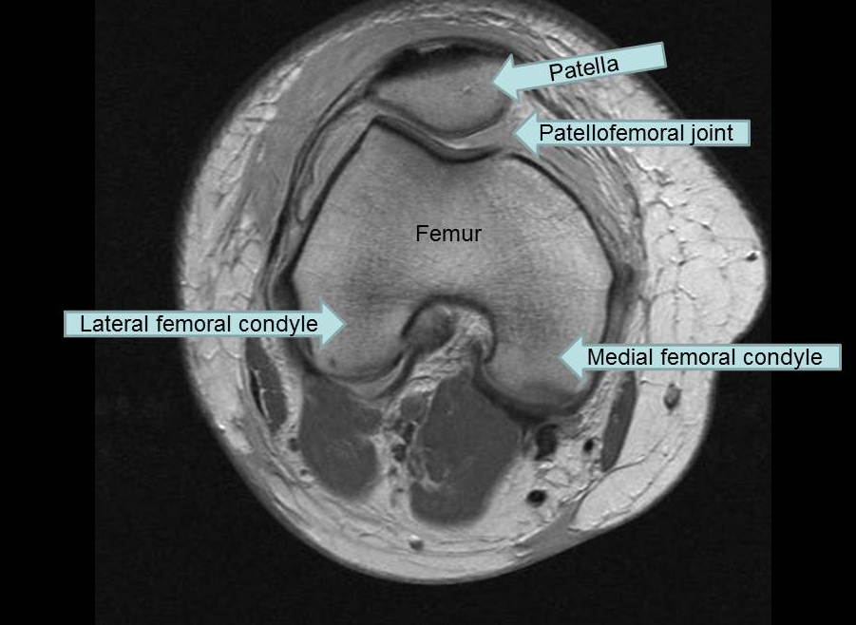
MRI MACHINE!

Slide 7
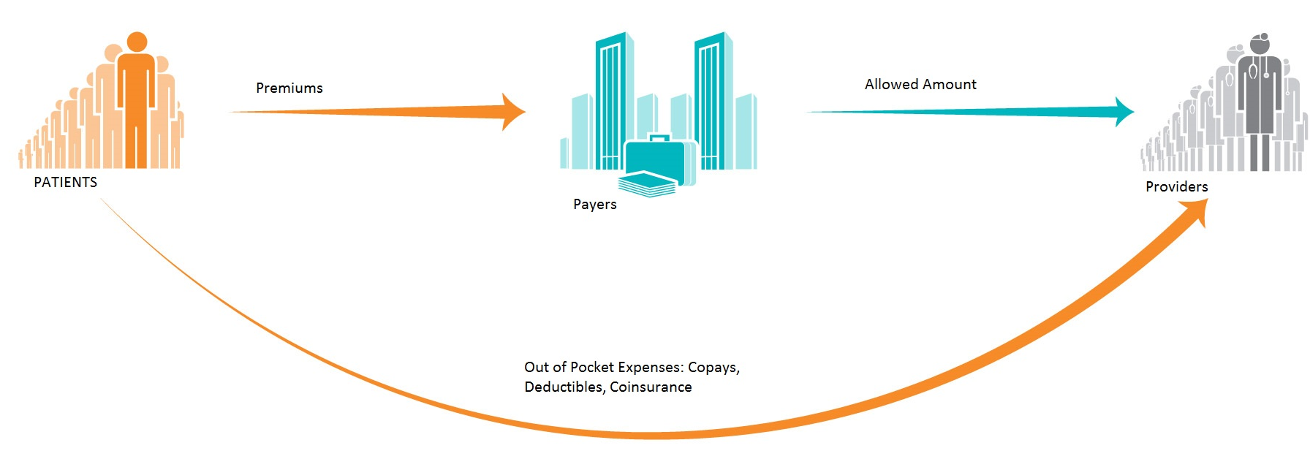
Payments in healthcare

Slide 8
Determinants of Allowed Amount and Price the Patient Pays
Allowed Amount: The total amount the provider and facility receive for performing and reading the MRI. Negotiated or set between providers/hospitals and insurers.
  Market conditions: number of providers in market.
  Location.
  Setting hospital / outpatient setting.
  Quality/consumer demand.

Slide 9
Out of Pocket Price the Patient Pays
Variation in plans.
Some charge a copay to see provider, usually flat fee regardless of provider in network.
Others charge a deductible with coinsurance.
  For example, Supposed Bob wants to purchase an MRI whose allowed amount is $600.
  if Bob has a plan with a $2,000 deductible and 20% coinsurance and Bob has already spent $1500 on health care.
  Bob’s out of pocket price is $520. $500 goes towards deductible, $20 comes from consinsurance.

Slide 10
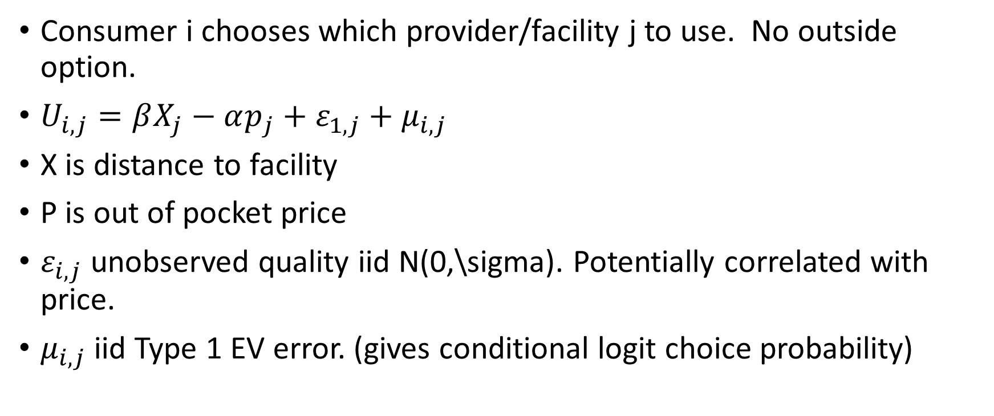
Model
Consumer i chooses which provider/facility j to use. No outside option.
$U_{i,j}=βX_{j}−αp_{j}+ε_{1,j}+μ_{i,j}$
X is distance to facility
P is out of pocket price
$ε_{i,j}$ unobserved quality iid N(0,\sigma). Potentially correlated with price.
$μ_{i,j}$ iid Type 1 EV error. (gives conditional logit choice probability)

Slide 11
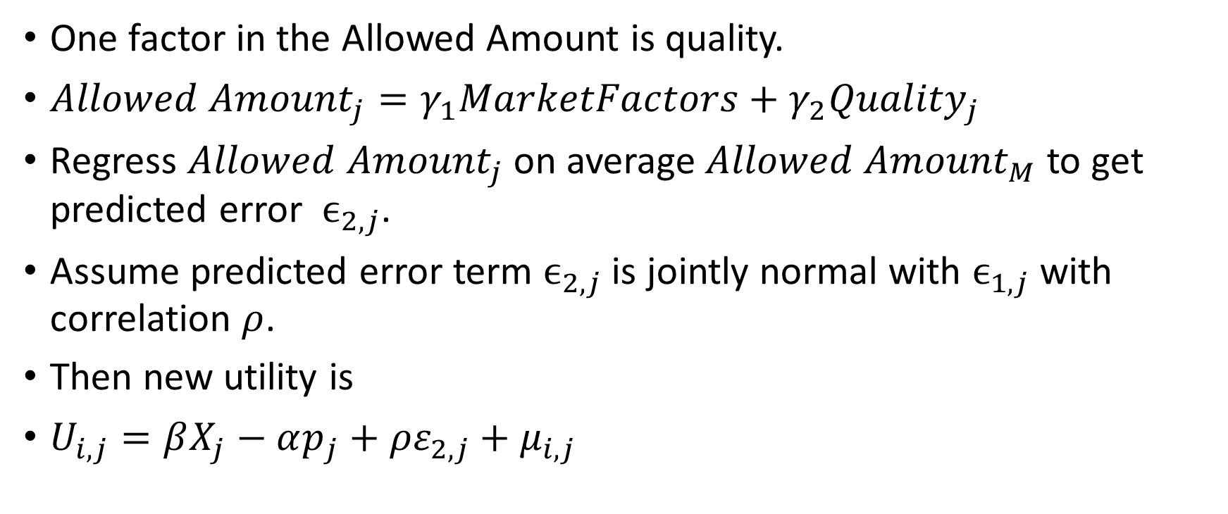
Instrument
One factor in the Allowed Amount is quality.
${Allowed Amount}_{j}=γ_{1}MarketFactors+γ_{2}{Quality}_{j }$
Regress ${Allowed Amount}_{j}$ on average ${Allowed Amount}_{M}$ to get predicted error $ϵ_{2,j}$.
Assume predicted error term $ϵ_{2,j}$ is jointly normal with $ϵ_{1,j}$ with correlation $ρ$.
Then new utility is
$U_{i,j}=βX_{j}−αp_{j}+{ρε}_{2,j}+μ_{i,j}$

Slide 12
DATA
Multi-payer claims database.
Limit to top 6 payers in state.
Only consider claims from patients and providers in state.
 | MEAN | SD
Allowed Amount | $587.27 | 359.95
OOP Price | $256.79 | 276.12
Travel Time | 23.97 | 67.09
number of Knee MRIs | 28,341

Slide 13
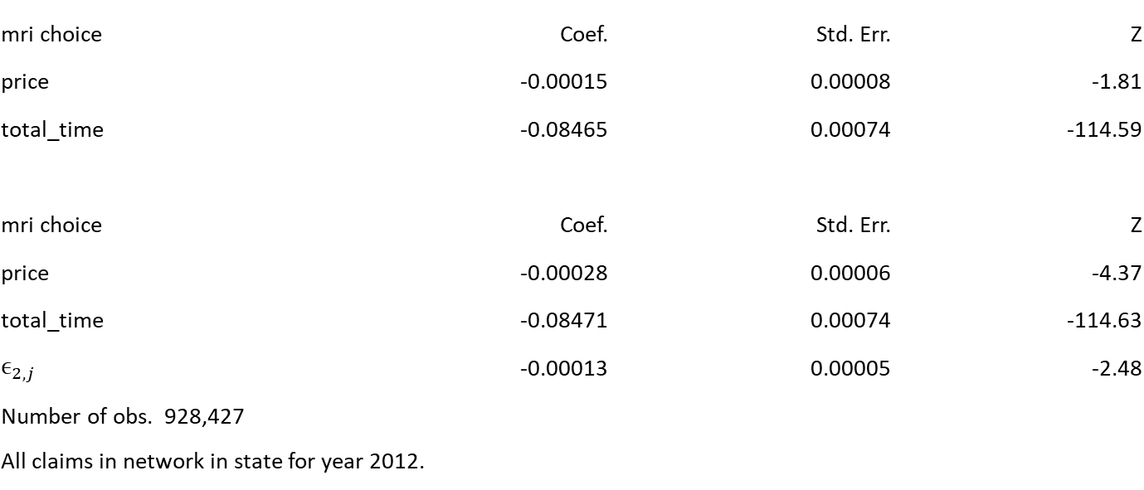
Estimates
mri choice | Coef. | Std. Err. | Z
price | -0.00015 | 0.00008 | -1.81
total_time | -0.08465 | 0.00074 | -114.59
mri choice | Coef. | Std. Err. | Z
price | -0.00028 | 0.00006 | -4.37
total_time | -0.08471 | 0.00074 | -114.63
$$ϵ_{2,j}$$ | -0.00013 | 0.00005 | -2.48
Number of obs. 928,427
All claims in network in state for year 2012.

Slide 14
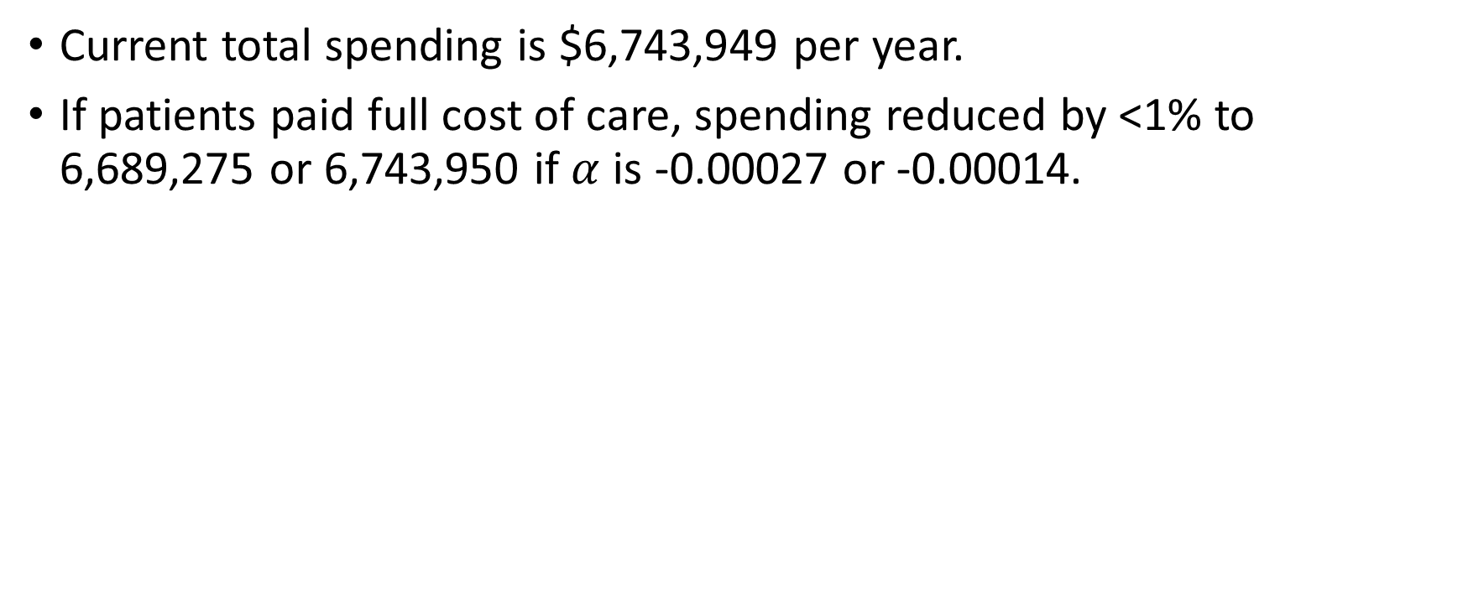
Potential Savings
Current total spending is $6,743,949 per year.
If patients paid full cost of care, spending reduced by <1% to 6,689,275 or 6,743,950 if $α$ is -0.00027 or -0.00014.

